Slide 1
Block 1 — Functional traits and functional space
13:45–14:35 · What is a functional trait? · Trait data and databases · From a trait table to a functional space · Reading a space: volume, overlap, uniqueness
Block 1 · Functional traits and functional space

Slide 2
What is a functional trait?
“Any morphological, physiological or phenological feature measurable at the individual level, from the cell to the whole-organism level, without reference to the environment or any other level of organisation.” A trait is functional when it affects fitness indirectly via its effects on performance (growth, reproduction, survival).
Violle et al. (2007) Oikos 116: 882–892
Measured on individuals — a species mean is a summary, and a choice (intraspecific variability is set aside)
Not a response — “abundance” or “presence in warm rivers” are defined with reference to the environment
Functional only through a mechanism — for fishes: body shape → locomotion, mouth position → feeding
Master FBE 2026 · Session 1 · Block 1 · Functional traits and functional space
6

Slide 3
Response traits, effect traits
Environment
(temperature, flow, O₂, fishing)
Response traits
Community
composition
Effect traits
Ecosystem processes
(production, nutrient cycling)
Lavorel & Garnier (2002) Functional Ecology 16: 545–556
Response trait — determines how a species responds to abiotic and biotic filters (streamlined body + narrow peduncle → sustained swimming in fast current)
Effect trait — determines how a species affects processes (a large sediment-stirring detritivore such as Prochilodus changes nutrient cycling and turbidity)
Many traits are both (body size responds to temperature and fishing; body size drives metabolic demand and prey size) — this overlap is what makes prediction possible
Master FBE 2026 · Session 1 · Block 1 · Functional traits and functional space
7

Slide 4
Kinds of traits, kinds of data
Type | Example (fish) | Coding | Distance later on
Quantitative | Body length (cm), fin aspect ratio | continuous number | Euclidean (after standardisation) or Gower
Ordinal | Position in water column: benthic < demersal < pelagic | ordered categories | Gower (ranks)
Nominal | Reproductive guild, diet category | unordered categories | Gower (0/1)
Binary | Migratory: yes / no | 0 / 1 | Gower
Fuzzy | Diet: 60 % invertebrates, 40 % plants | proportions across categories | Gower on proportions
The data type decides the distance you can compute — and the more categorical traits, the coarser the functional space. Hence the investment in continuous morphological traits for fishes.
Master FBE 2026 · Session 1 · Block 1 · Functional traits and functional space
8

Slide 5
Where traits come from: databases
Database | Group | Content | Reference
TRY | Plants | Millions of records, > 100,000 species | Kattge et al. 2020
AVONET | Birds | Beak, wing, tail, tarsus for ~all species | Tobias et al. 2022
EltonTraits | Birds, mammals | Diet and foraging traits | Wilman et al. 2014
COMPADRE / COMADRE | Plants / animals | Demographic matrices | Salguero-Gómez et al. 2015–2016
FishBase | Fishes | Life history, ecology; uneven coverage | Froese & Pauly
FISHMORPH | Freshwater fishes | 10 standardised morphological traits, > 8,000 species, one protocol | Brosse et al. 2021 GEB
Thursday’s traits are a simplified version of the FISHMORPH traits.
Master FBE 2026 · Session 1 · Block 1 · Functional traits and functional space
9

Slide 6
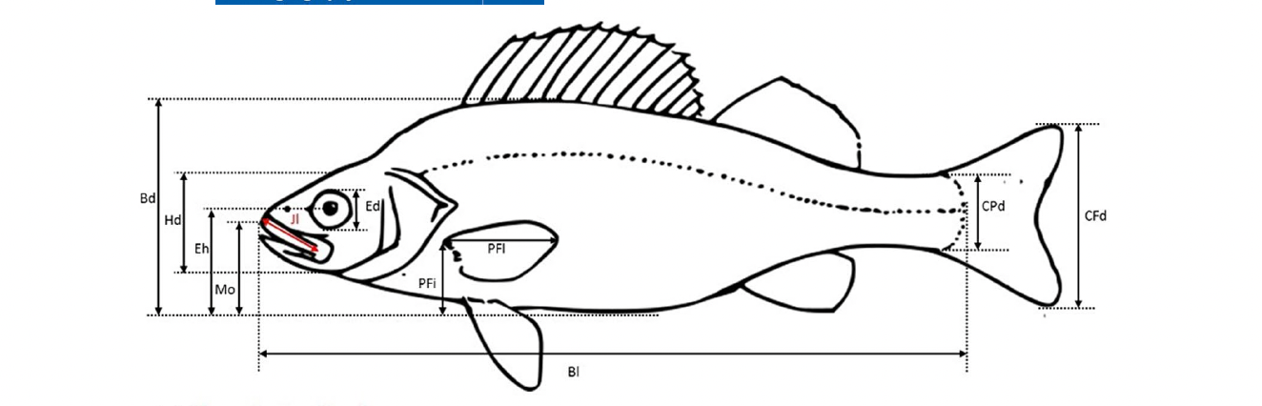
The fish morphological trait framework (Villéger et al. 2017)
Locomotion (6)
Body elongation
Lateral compression
Pectoral fin aspect ratio
Pectoral fin position
Caudal peduncle throttling
Caudal fin aspect ratio
Feeding (4)
Body size
Mouth position (inferior / terminal / superior)
Oral gape
Eye size
Design principles: ratios (size-free) · a mechanistic meaning for each · measurable on any species from a photograph.
Master FBE 2026 · Session 1 · Block 1 · Functional traits and functional space
10

Slide 7
Data quality: three questions before any analysis
Completeness
Plausibility
Resolution
% missing per trait and per species. Rule used here: drop species with > 30 % missing traits; impute the rest if needed — and report it.
Outliers, units, ratios outside anatomical limits (a peduncle ratio < 1, a 3-m tetra). Check distributions.
Species means: how many individuals? How variable within species? Body size in fishes: juvenile and adult are different animals.
On Thursday, Step 1 of every exercise is exactly this check.
Master FBE 2026 · Session 1 · Block 1 · Functional traits and functional space
11

Slide 8
From a trait table to distances between species
Species | BL (cm) | BD ratio | Mouth pos.
Hoplias | 53 | 0.13 | 0.74
Prochilodus | 12 | 0.26 | 0.51
Cichla | 40 | 0.27 | 0.55
Arapaima | 200 | 0.14 | 0.62
 | Hop | Pro | Cic | Ara
Hop | 0
Pro | d | 0
Cic | d | d | 0
Ara | d | d | d | 0
All traits quantitative → Euclidean distance on standardised traits (centre, divide by SD): otherwise body length in cm dominates every ratio
Mixed traits → Gower distance (Gower 1971): per-trait |difference| / range, 0/1 for categories, averaged over traits; bounded 0–1; skips missing values; traits can be weighted — FD::gowdis()
Master FBE 2026 · Session 1 · Block 1 · Functional traits and functional space
12

Slide 9
From distances to a space: PCA and PCoA
 | PCA | PCoA
Input | Standardised quantitative traits | Any distance matrix (e.g. Gower)
Axes | Linear combinations of traits, with loadings | Coordinates that reproduce the distances
Interpretation | Direct (loadings) | A posteriori (correlate axes with traits)
Trait types | Quantitative only | Any
Caveat | Sensitive to outliers | Negative eigenvalues if the distance is not Euclidean → correction (Cailliez, Lingoes)
R | prcomp() | cmdscale(), ape::pcoa(), inside FD::dbFD()
Same output in both cases: a matrix of species coordinates on a few axes. Everything downstream works on that matrix.
Master FBE 2026 · Session 1 · Block 1 · Functional traits and functional space
13

Slide 10
How many axes? The quality of the functional space
“70 % of variance” is a habit, not a quality criterion
Maire et al. (2015): mean squared deviation between original and reduced-space distances; stop where improvement becomes negligible — 4 axes for global fish morphology, 2 axes distort
Convex hulls need more species than axes and get unstable in high dimension → 4–5 axes max
Report the choice; test sensitivity (3 vs 4 axes)
Master FBE 2026 · Session 1 · Block 1 · Functional traits and functional space
14

Slide 11
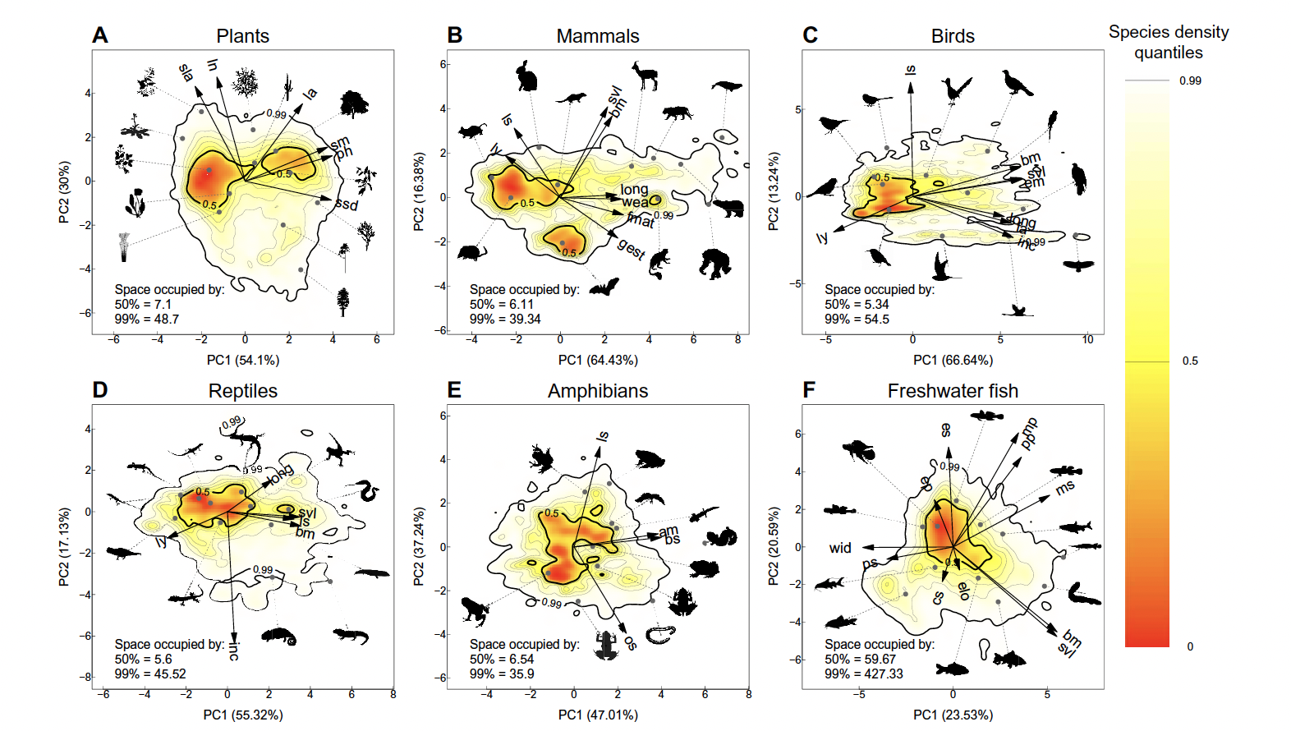
Reading a functional space: the global freshwater fish fauna
Axis 1: elongated, small-finned bodies ↔ deep, compressed, large-finned bodies (swimming mode)
Axis 2: mouth position and eye size (bottom ↔ surface feeding)
A dense generalist core; edges held by few species from few lineages (knifefishes, loricariids, discus-shaped cichlids)
Neotropics: by far the largest hull — roughly three quarters of global fish functional diversity (Toussaint et al. 2016)
Master FBE 2026 · Session 1 · Block 1 · Functional traits and functional space
15

Slide 12
Three descriptors of a space: volume, overlap, uniqueness
Volume (FRic)
Overlap
Uniqueness
Convex hull of the species: the range of strategies. Sensitive to extremes.
Fraction of one hull inside the other: do two faunas “do the same things”?
Distance to the nearest neighbour: what no other species does. Relative to the pool!
Master FBE 2026 · Session 1 · Block 1 · Functional traits and functional space
16

Slide 13
Visualising the space: hulls, kernels, funspace
Convex hulls: simple, but one outlier makes the hull look huge
Kernel densities: show the dense core and the sparse periphery; thresholds at 50 % / 99 %
funspace (Carmona et al.): two lines of code; can use abundances and intraspecific data
Thursday: ellipses and hulls in ggplot2; funspace as optional extension (Group A)
Master FBE 2026 · Session 1 · Block 1 · Functional traits and functional space
17

Slide 14
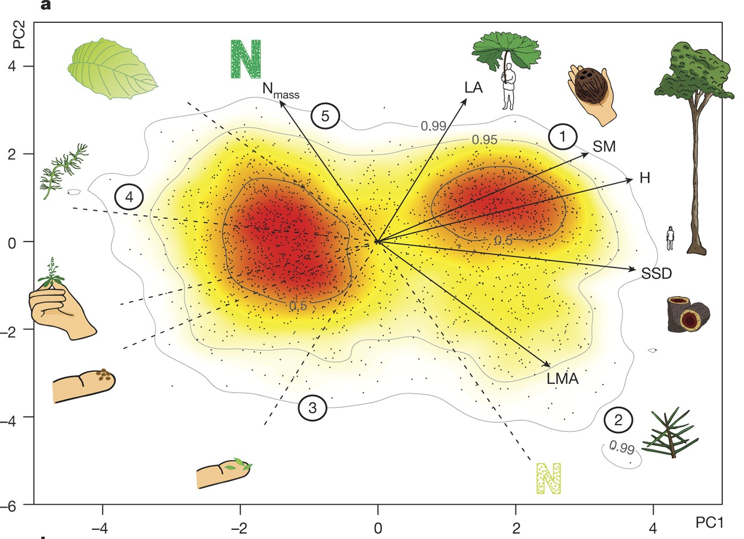
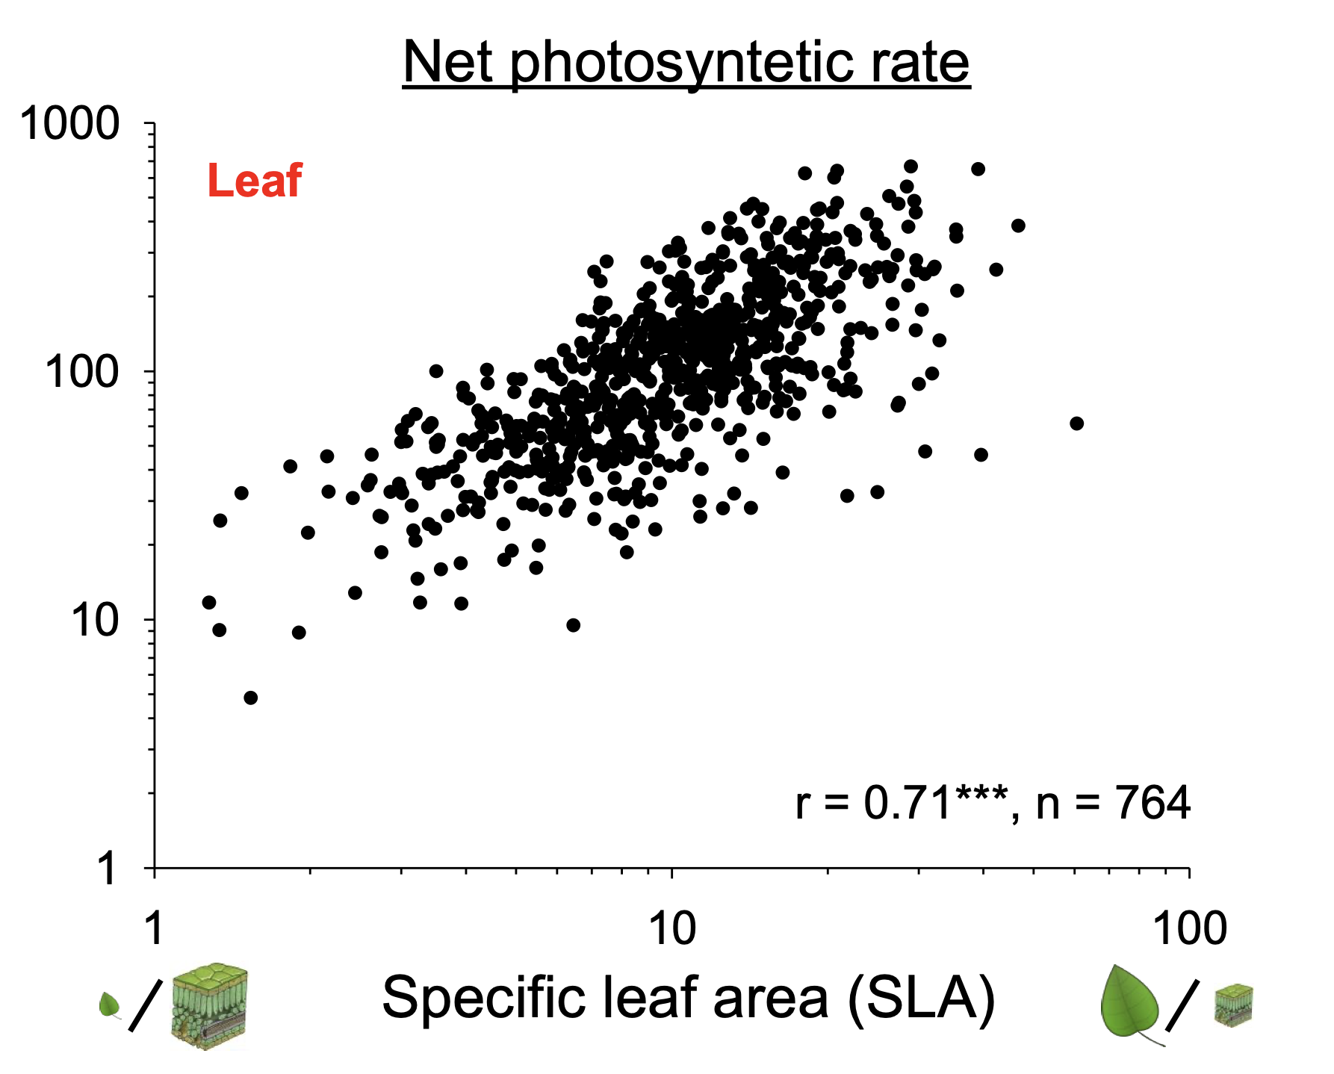
The plant precedent: leaf economics and the global spectrum of form and function
One axis (2,500 species): cheap, short-lived, fast leaves ↔ expensive, long-lived, slow leaves — an acquisition/conservation trade-off
Two axes for whole plants (46,000 species): size and leaf economics; a dense core and large empty regions of the possible space
Lesson: a few major axes, a dense core, empty corners — the same structure appears in fishes
Master FBE 2026 · Session 1 · Block 1 · Functional traits and functional space
18

Slide 15
Choosing traits: the questions to ask yourself
What process am I interested in? Response to what? Effect on what? — start from the question, not from the database
Is the link trait → performance established, or at least plausible?
Is the trait measurable for all my species? (a trait known for half the species forces dropping or imputing half the data)
Are my traits redundant? r = 0.9 is one trait counted twice
Is the trait set balanced? Six locomotion traits + one trophic trait = a locomotion space
Be able to justify a trait set in one sentence per trait — Group A will check trait correlations on Thursday.
Master FBE 2026 · Session 1 · Block 1 · Functional traits and functional space
19

Slide 16
Block 1 — take-home
1
A functional trait is measured on individuals and linked to performance through a mechanism; response, effect, or both
2
Standardise; Euclidean or Gower distance; PCA or PCoA → species coordinates
3
Choose, report and test the number of axes (quality of the space)
4
Read a space with volume, overlap and uniqueness — all relative to a species pool
Break — 10 min. Next: communities in the space.
Master FBE 2026 · Session 1 · Block 1 · Functional traits and functional space
20

