Slide 1
Trait-based approach
in community ecology
Day 3 — Trait–Environment Relationships
& Extinction Consequences
RLQ · Fourth-corner · FUSE · Amazonian fish
Belém, Pará · Amazon, Brazil

Slide 2
Day 3 — Programme overview
01
02
03
04
05
Trait–Environment Relationships
Fourth-corner test
Extinction & BEF
FUSE — Conservation index
R Practical
RLQ in context · Landmark studies · Reading biplots · Biological insights
From visual to statistics · Permutations · Heatmap interpretation
Why extinction order matters · 3 scenarios · Reading FRic curves
FUn · FSpec · IUCN weight · Top-5 Amazonian priorities
{ade4} · {FD} · {funrar} — RLQ + 4C + extinction + FUSE pipeline
Day 3 · Belém · 02 / 32
Trait-Based Ecology — Day 3 · Trait–Environment & Extinction · Belém, Brazil

Slide 3
Part 1
Trait–Environment
Relationships
RLQ ordination · Fourth-corner test · Amazonian gradients
Day 3 · Belém · 03 / 32

Slide 4
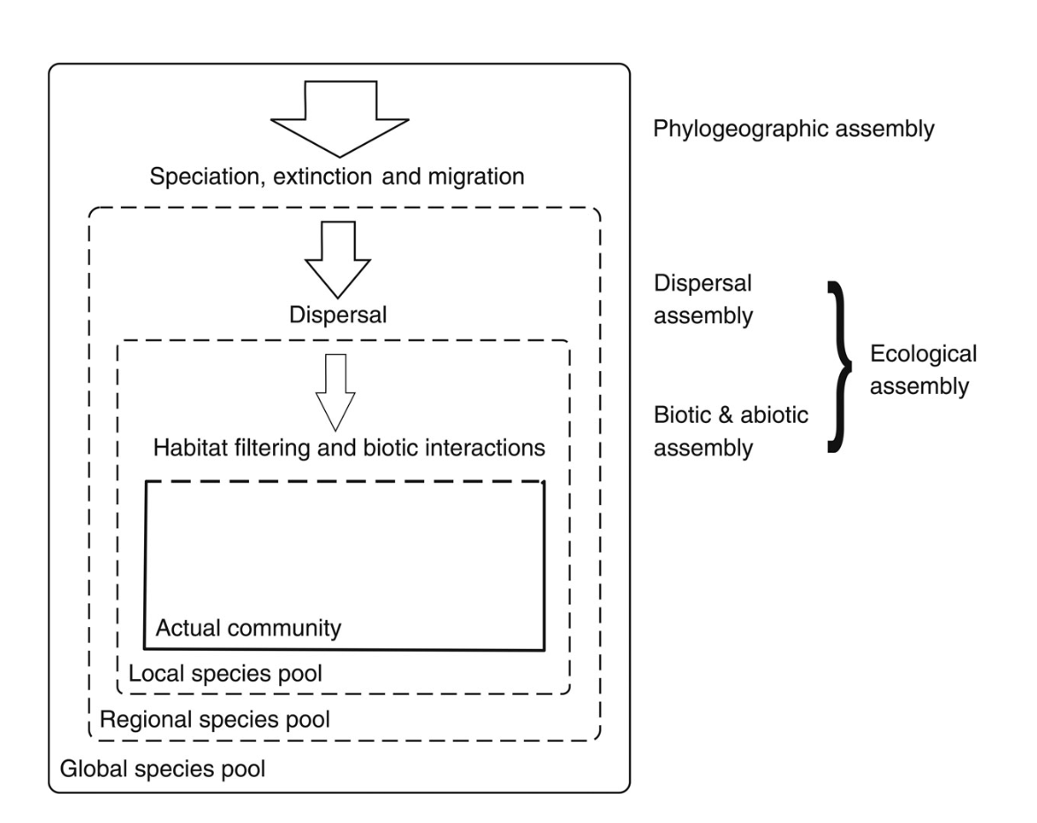
The environmental-filtering metaphor
MOTIVATION
Core idea
Local environmental conditions filter species from the regional pool by selecting trait values compatible with abiotic stress (Keddy 1992; Diaz et al. 1998).
Operational predictions
Lower trait variance than expected under random assembly (trait convergence).
Trait–environment correlations along gradients.
Critique (Kraft et al. 2015; Cadotte & Tucker 2017)
Equating ‘convergence’ with ‘abiotic filtering’ ignores biotic interactions, equalising fitness differences, and competitive exclusion.
Use the metaphor as a hypothesis, not as an explanation.
Trait-Based Ecology — Day 3 · RLQ · Fourth-corner · FUSE · Extinction simulations · Belém, Brazil

Slide 5
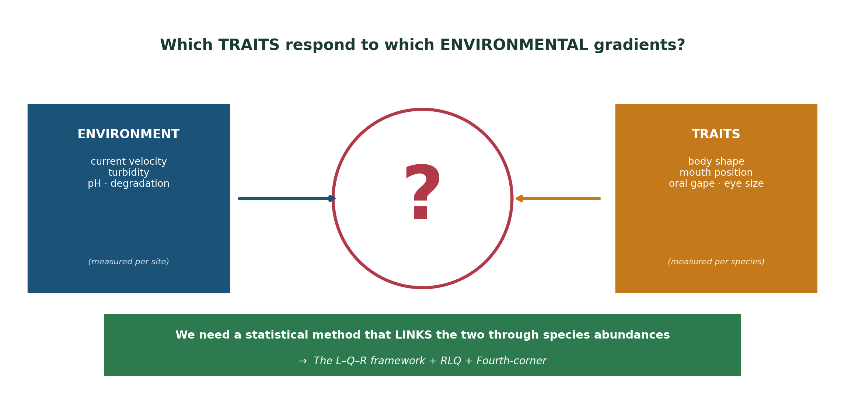
The trait–environment problem — what we want to know
MOTIVATION
Pedagogical anchor
Imagine 12 sites along an Amazonian river. Some have fast current, others have slow flow. Each site has 5–20 fish species. Each species has 10 morphological traits.
Question: which TRAITS predict where each SPECIES is found?
Trait-Based Ecology — Day 3 · RLQ · Fourth-corner · FUSE · Extinction simulations · Belém, Brazil

Slide 6
Why simple correlations are not enough
THEORY
✗ Approach 1 — CWM ~ env
Compute CWM(trait) per site, regress on environment.
PROBLEM: collapses all species into one mean.
PROBLEM: ignores variance within each site.
LOSES information about which SPECIES drives the pattern.
Day 3 · Belém · 05 / 32
Trait-Based Ecology — Day 3 · Trait–Environment & Extinction · Belém, Brazil

Slide 7
Why simple correlations are not enough
THEORY
✗ Approach 1 — CWM ~ env
✗ Approach 2 — Correlate trait & env directly
Compute CWM(trait) per site, regress on environment.
PROBLEM: collapses all species into one mean.
PROBLEM: ignores variance within each site.
LOSES information about which SPECIES drives the pattern.
Pair each species with its 'preferred' environment.
PROBLEM: there is no direct R × Q matrix.
PROBLEM: must go through L (abundances) — but how?
This is the 'fourth-corner problem'.
Day 3 · Belém · 05 / 32
Trait-Based Ecology — Day 3 · Trait–Environment & Extinction · Belém, Brazil

Slide 8
Why simple correlations are not enough
THEORY
✗ Approach 1 — CWM ~ env
✗ Approach 2 — Correlate trait & env directly
✓ Approach 3 — RLQ + Fourth-corner
Compute CWM(trait) per site, regress on environment.
PROBLEM: collapses all species into one mean.
PROBLEM: ignores variance within each site.
LOSES information about which SPECIES drives the pattern.
Pair each species with its 'preferred' environment.
PROBLEM: there is no direct R × Q matrix.
PROBLEM: must go through L (abundances) — but how?
This is the 'fourth-corner problem'.
Three tables analysed JOINTLY.
Site weights from L are used in env (R) ordination.
Species weights from L are used in trait (Q) ordination.
Result: axes maximise covariance traits ↔ environment.
Day 3 · Belém · 05 / 32
Trait-Based Ecology — Day 3 · Trait–Environment & Extinction · Belém, Brazil

Slide 9
Why simple correlations are not enough
THEORY
✗ Approach 1 — CWM ~ env
✗ Approach 2 — Correlate trait & env directly
✓ Approach 3 — RLQ + Fourth-corner
Compute CWM(trait) per site, regress on environment.
PROBLEM: collapses all species into one mean.
PROBLEM: ignores variance within each site.
LOSES information about which SPECIES drives the pattern.
Pair each species with its 'preferred' environment.
PROBLEM: there is no direct R × Q matrix.
PROBLEM: must go through L (abundances) — but how?
This is the 'fourth-corner problem'.
Three tables analysed JOINTLY.
Site weights from L are used in env (R) ordination.
Species weights from L are used in trait (Q) ordination.
Result: axes maximise covariance traits ↔ environment.
RLQ and Fourth-corner are the natural answer to the trait–environment problem because they handle the L bridge explicitly.
Day 3 · Belém · 05 / 32
Trait-Based Ecology — Day 3 · Trait–Environment & Extinction · Belém, Brazil

Slide 10
The L–Q–R framework — three tables, one question
THEORY
R
L
Q
Sites × Environment
Sites × Species
Species × Traits
12 sites × 8 variables
(current, depth, pH, turbidity…)
12 sites × 30 species
(abundances)
30 species × 10 traits
(Body_elong, Mouth_pos…)
Critical: matching dimensions across tables
Site names MUST match between R (rows) and L (rows).
Species names MUST match between L (columns) and Q (rows).
Always verify with: setdiff(rownames(R), rownames(L)) ; setdiff(colnames(L), rownames(Q))
If even ONE mismatch: rlq() will throw cryptic errors. Spend 5 min checking dimensions BEFORE running the analysis.
Day 3 · Belém · 06 / 32
Trait-Based Ecology — Day 3 · Trait–Environment & Extinction · Belém, Brazil

Slide 11
RLQ — what questions does it answer?
RLQ is not a statistic. It is a framework to ASK biological questions about trait–environment matching.
Q1 — Which environmental gradients structure the community?
Q2 — Which traits respond to those gradients?
Beyond species lists — what abiotic axes matter ecologically?
Identify the response traits — the ones doing the filtering work.
Q3 — Which species occupy the extremes?
Q4 — Are trait–environment links predictable?
Locate the response specialists — the ecological 'characters' of the system.
Test whether observed associations beat chance — the fourth-corner step.
Day 3 · Belém · 08 / 32
Trait-Based Ecology — Day 3 · Trait–Environment & Extinction · Belém, Brazil

Slide 12
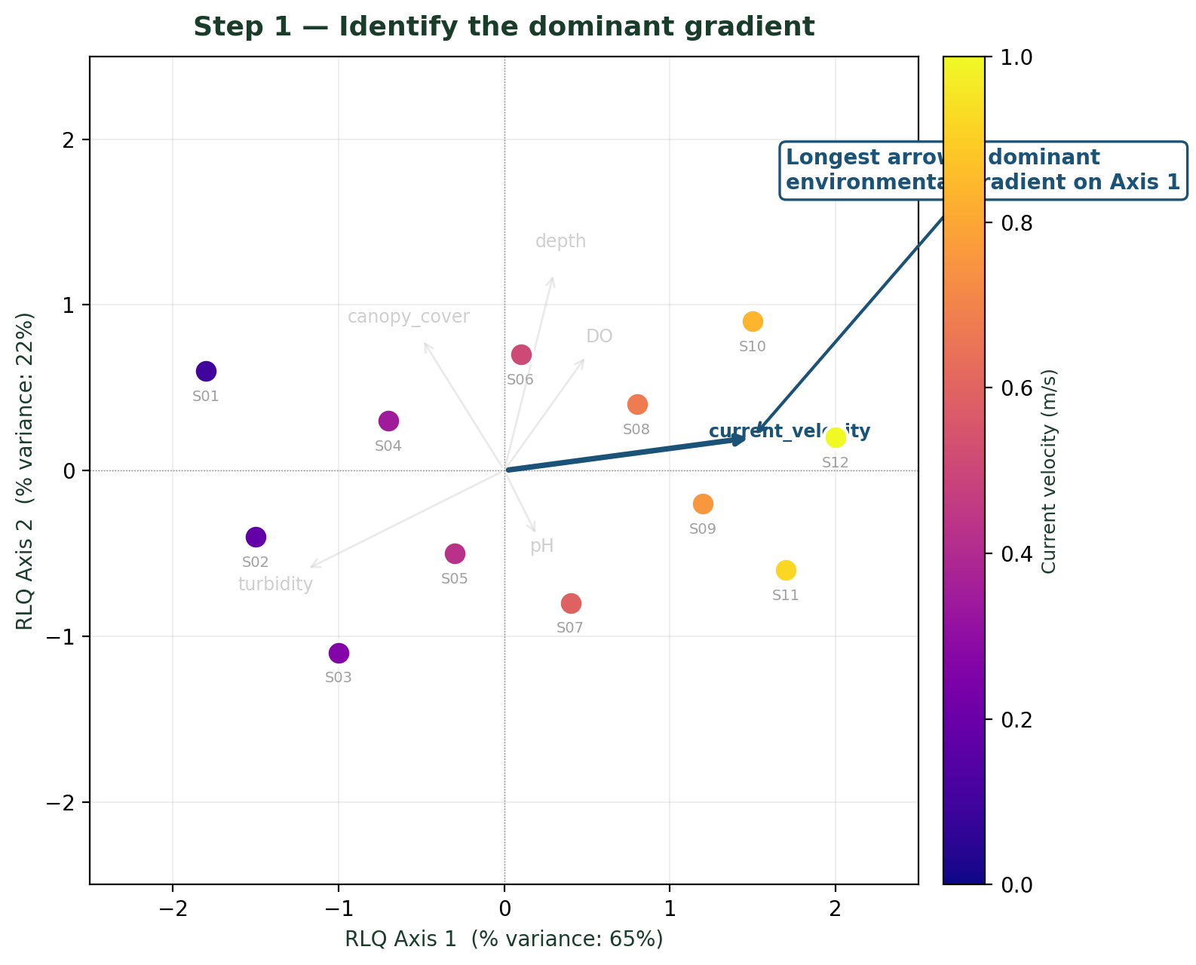
Step 1 — Identify the dominant gradient
STEP 1
What to look at
The LONGEST environmental arrow on Axis 1.
Length ∝ contribution to the axis. The longest arrow is the strongest environmental driver in your community.
Longest arrows dominant environmental gradient on Axis 1
What to read
Site colours / values along the arrow tell you which sites have HIGH (positive end) vs LOW (negative end) values of the gradient.
What to write
"Axis 1 captures a [variable name] gradient."
This is the FIRST sentence of your interpretation.
Day 3 · Belém · 10 / 32
Trait-Based Ecology — Day 3 · Trait–Environment & Extinction · Belém, Brazil

Slide 13
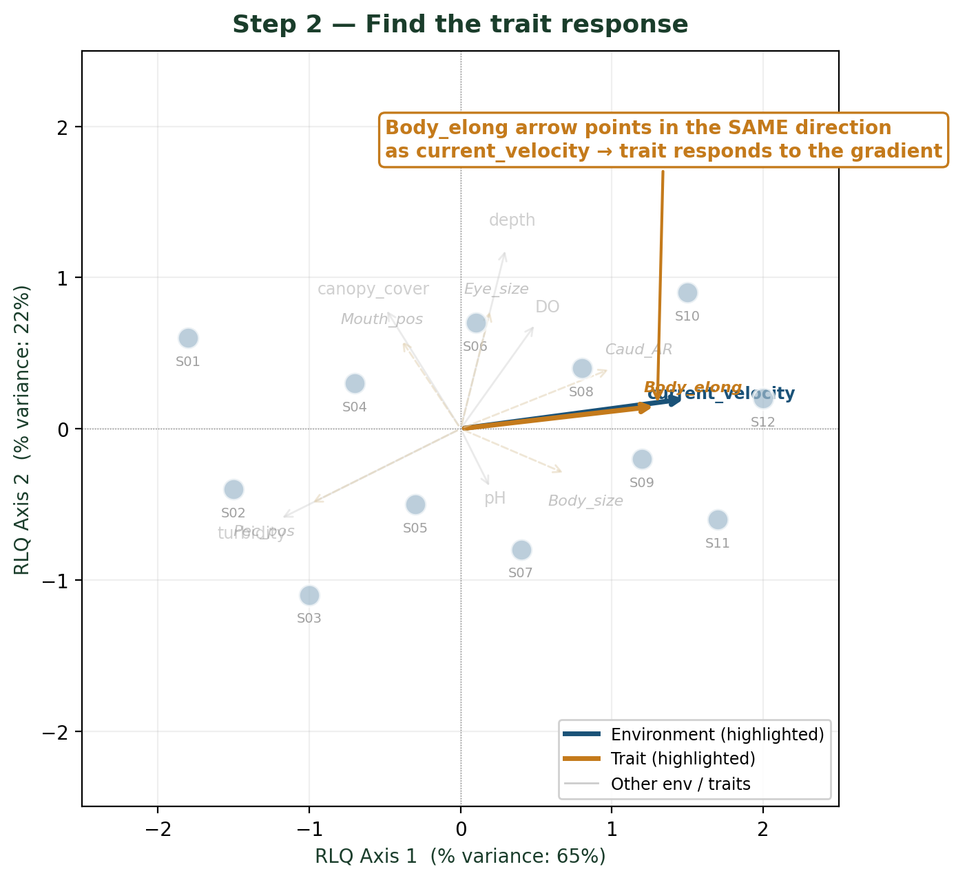
Step 2 — Find the trait response
STEP 2
What to look at
Trait arrows pointing in the SAME direction as the longest environmental arrow.
Same direction = positive trait–environment association. Opposite direction = negative association.
What to read
If trait T points the same way as env E, then high-E sites host species with high-T values.
What to write
"[Trait] responds to [environment]."
This is the response trait — the hypothesis to test with the fourth-corner.
Day 3 · Belém · 11 / 32
Trait-Based Ecology — Day 3 · Trait–Environment & Extinction · Belém, Brazil

Slide 14
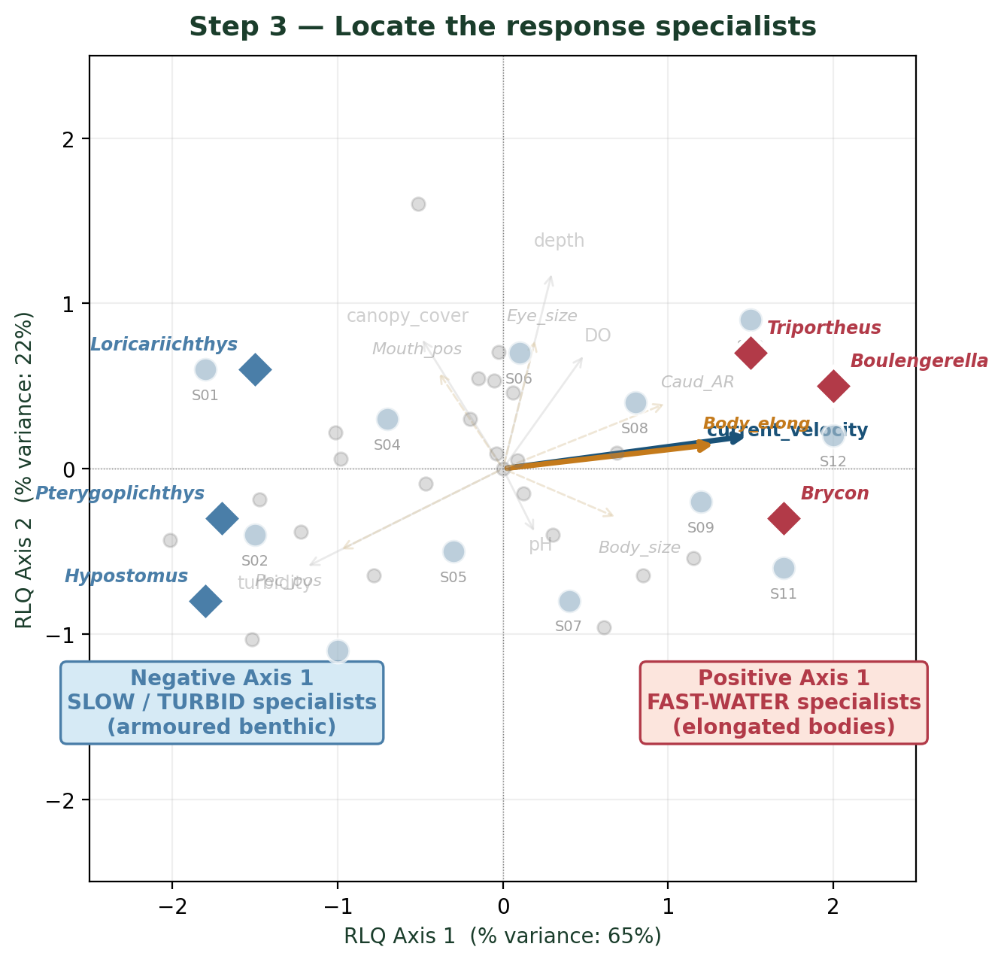
Step 3 — Locate the response specialists
STEP 3
What to look at
Species at the EXTREMES of Axis 1 — both ends.
These species carry the strongest trait–environment signal. They are the 'characters' of your story.
What to read
Positive extreme = specialists of high-E environments. Negative extreme = specialists of low-E environments.
What to write
"Species A, B, C are specialists of high-E. Species X, Y, Z are specialists of low-E."
Cross-check with their published autecology.
Day 3 · Belém · 12 / 32
Trait-Based Ecology — Day 3 · Trait–Environment & Extinction · Belém, Brazil

Slide 15
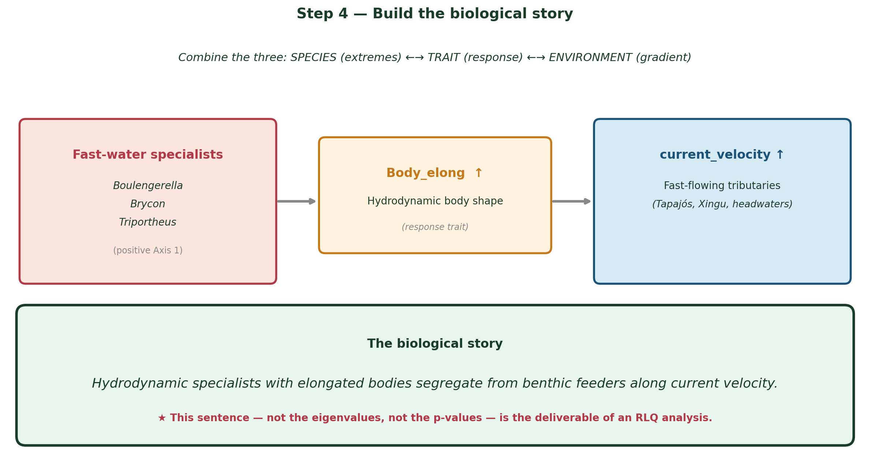
Step 4 — Build the biological story
STEP 4
The ONE-sentence deliverable
Combine SPECIES (extremes) ←→ TRAIT (response) ←→ ENVIRONMENT (gradient) into a SINGLE biological sentence — that's your RLQ result.
Day 3 · Belém · 13 / 32
Trait-Based Ecology — Day 3 · Trait–Environment & Extinction · Belém, Brazil

Slide 16
Part 2
Extinction & Ecosystem
Functioning
BEF mechanisms · Trait-based vulnerability · FUSE · Functional space erosion
Day 3 · Belém · 18 / 32

Slide 17
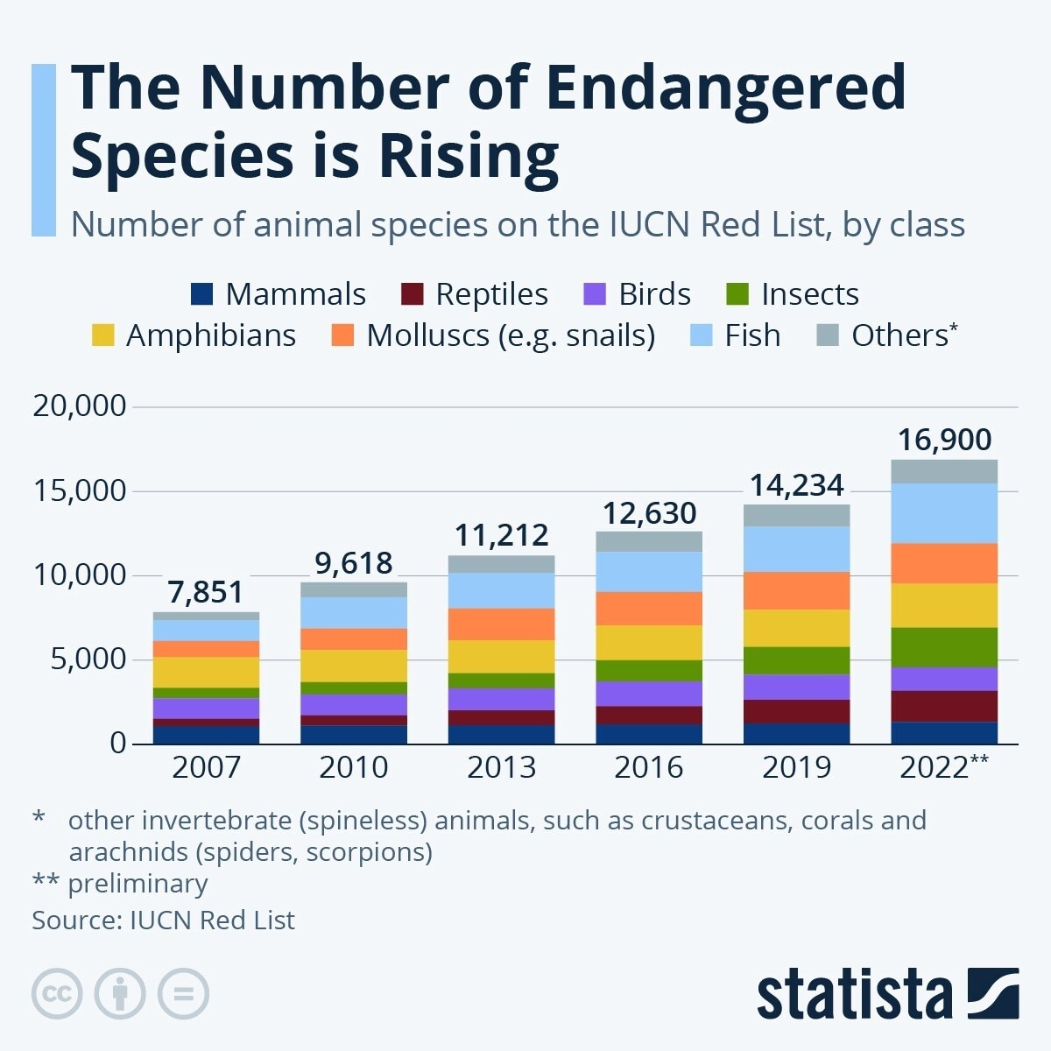
Why model extinction in functional space?
MOTIVATION
If we lose species, do we lose FUNCTIONAL DIVERSITY at the same rate, or differently?
Trait-Based Ecology — Day 3 · RLQ · Fourth-corner · FUSE · Extinction simulations · Belém, Brazil

Slide 18
Why model extinction in functional space?
MOTIVATION
If we lose species, do we lose FUNCTIONAL DIVERSITY at the same rate, or differently?
Trait-Based Ecology — Day 3 · RLQ · Fourth-corner · FUSE · Extinction simulations · Belém, Brazil

Slide 19
Why model extinction in functional space?
MOTIVATION
If we lose species, do we lose FUNCTIONAL DIVERSITY at the same rate, or differently?
The pessimistic scenario
Threatened species are FUNCTIONALLY UNIQUE.
→ Loss of FD is FASTER than loss of species richness.
→ Ecosystem function declines abruptly because the lost species carried unique roles.
Trait-Based Ecology — Day 3 · RLQ · Fourth-corner · FUSE · Extinction simulations · Belém, Brazil

Slide 20
Why model extinction in functional space?
MOTIVATION
If we lose species, do we lose FUNCTIONAL DIVERSITY at the same rate, or differently?
The pessimistic scenario
The optimistic scenario
Threatened species are FUNCTIONALLY UNIQUE.
→ Loss of FD is FASTER than loss of species richness.
→ Ecosystem function declines abruptly because the lost species carried unique roles.
Threatened species are FUNCTIONALLY REDUNDANT.
→ Loss of FD is SLOWER than loss of species richness.
→ Ecosystem function is buffered by redundancy.
Rare in tropical systems where unique species dominate.
Trait-Based Ecology — Day 3 · RLQ · Fourth-corner · FUSE · Extinction simulations · Belém, Brazil

Slide 21
Why model extinction in functional space?
MOTIVATION
If we lose species, do we lose FUNCTIONAL DIVERSITY at the same rate, or differently?
The pessimistic scenario
The optimistic scenario
Threatened species are FUNCTIONALLY UNIQUE.
→ Loss of FD is FASTER than loss of species richness.
→ Ecosystem function declines abruptly because the lost species carried unique roles.
Threatened species are FUNCTIONALLY REDUNDANT.
→ Loss of FD is SLOWER than loss of species richness.
→ Ecosystem function is buffered by redundancy.
Rare in tropical systems where unique species dominate.
Simulating extinction lets us TEST which scenario applies to a given community — and predict the consequences of ongoing biodiversity loss.
Trait-Based Ecology — Day 3 · RLQ · Fourth-corner · FUSE · Extinction simulations · Belém, Brazil

Slide 22
Three extinction scenarios — what each one tests
THEORY
Scenario A — Random
Scenario B — Least abundant first
Scenario C — Most threatened first
Species are removed in RANDOM order.
Defines the EXPECTED FD loss under no biological selection.
Acts as a null model against which B and C are compared.
Generated by sample() in R — typically 100–1000 random orders.
Rare species are removed FIRST.
Mimics habitat-loss-driven rarity effects.
Tests: are rare species functionally unique or redundant?
In Amazonia, rare fish (raias, large catfish) tend to be unique.
Species are removed in IUCN order (CR → EN → VU → NT → LC).
Mimics realistic extinction debt under current trajectories.
Tests Mouillot's 'rare species support vulnerable functions'.
Most ecologically realistic — and most pessimistic.
Always compare ALL THREE on the same plot — the gap between curves reveals the non-randomness of extinction.
Trait-Based Ecology — Day 3 · RLQ · Fourth-corner · FUSE · Extinction simulations · Belém, Brazil

Slide 23
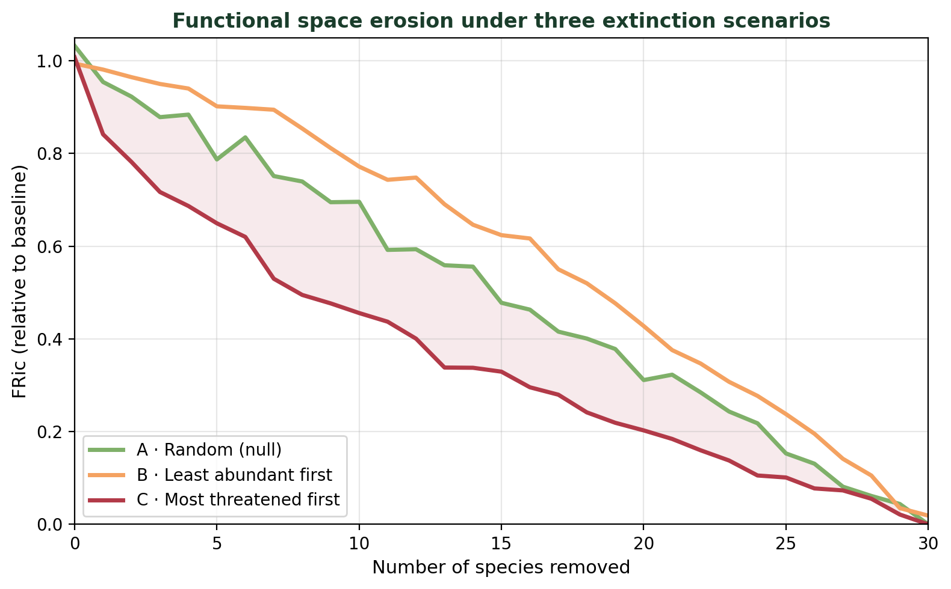
Three extinction scenarios — functional space erosion
THEORY
Threat-sorted extinction (red) erodes FRic faster than random (green) — Mouillot et al. 2013

Slide 24
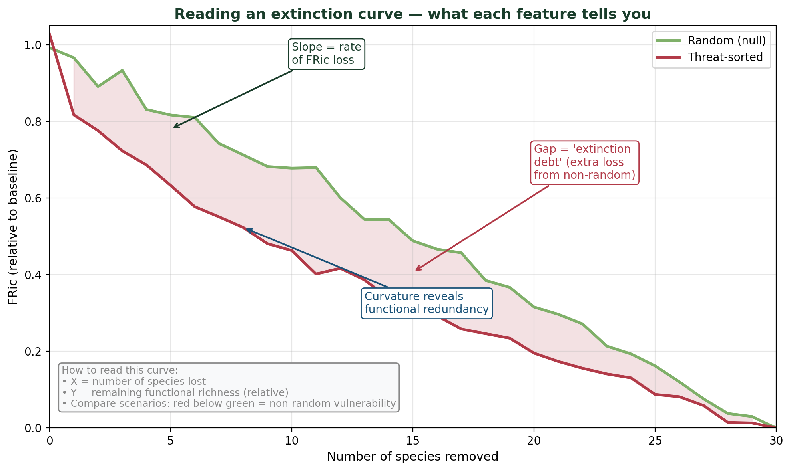
Reading an extinction curve — what each feature tells you
THEORY
★ Always plot RELATIVE FRic (% of baseline) so different communities are comparable.
Trait-Based Ecology — Day 3 · RLQ · Fourth-corner · FUSE · Extinction simulations · Belém, Brazil

Slide 25
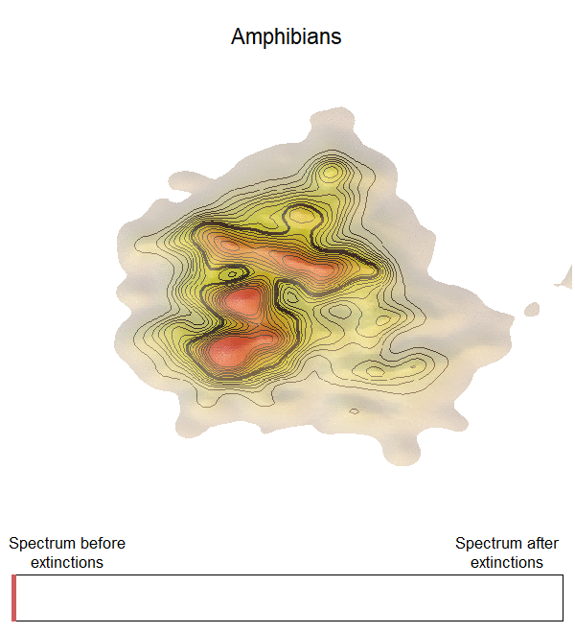
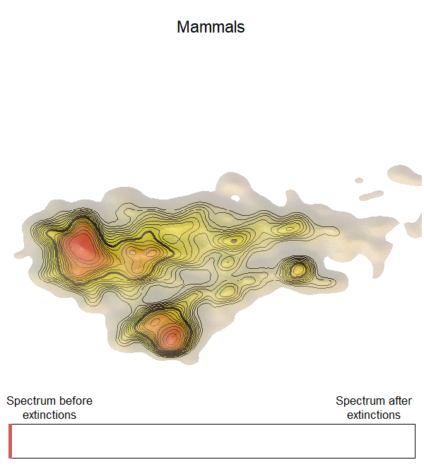
Causes of extinction
Carmona C., Tamme R., Pärtel M, …, Toussaint A. 2021

Slide 26
Causes of extinction
Carmona C., Tamme R., Pärtel M, …, Toussaint A. 2021

Slide 27
Global spectra of 6 terrestrial groups
Changes in functional spectra
Reduced lost space
(1 – 13%)
Erosion within spectra
Large reorganization of the functional space
Carmona C., Tamme R., Pärtel M, …, Toussaint A. 2021

Slide 28
Global spectra of 6 terrestrial groups
Threatened species
Large
“Slow” pace of life
Low fecundity
Up to 8x difference in threat risk
High variability
Carmona C., Tamme R., Pärtel M, …, Toussaint A. 2021

Slide 29
Introduction/extinction

Slide 30
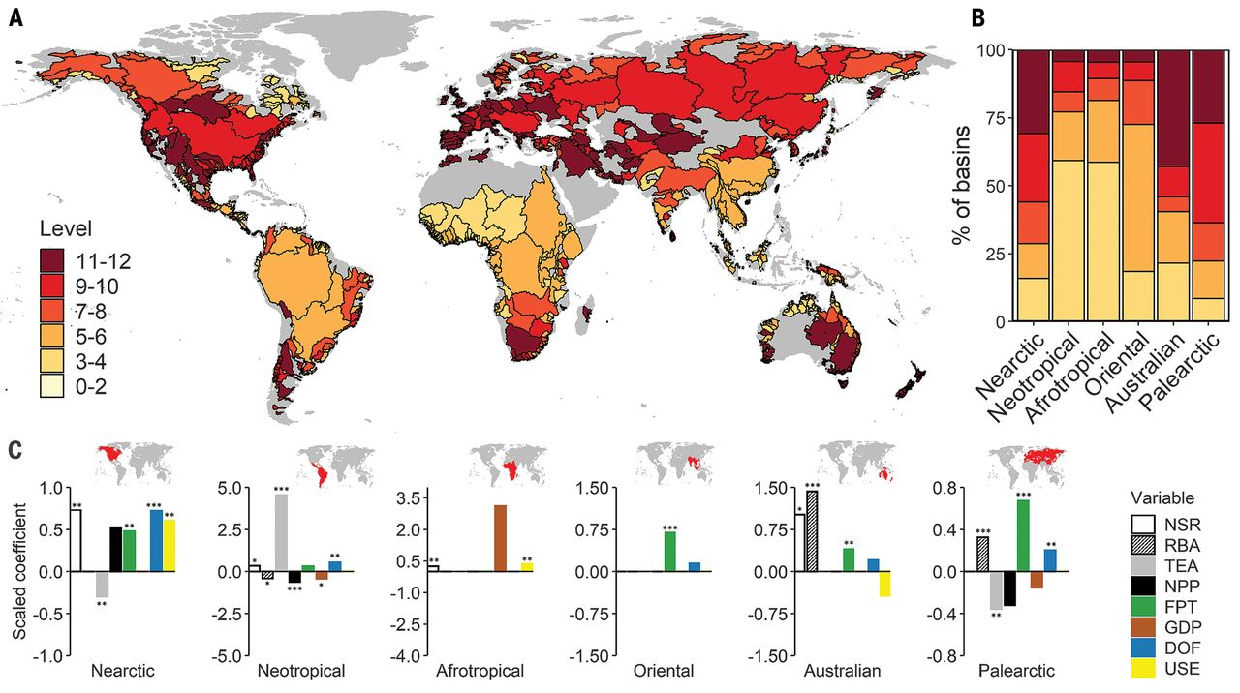
Introduction/extinction
Non-native species are functional distinct than native species
Su et al. 2021
Toussaint et al. 2018

Slide 31
FUSE — the conservation index
THEORY
FUSE = FUn × FSpec × IUCN_weight
Functionally Unique, Specialised and Endangered (Pimiento et al. 2020 Sci. Adv.)
Trait-Based Ecology — Day 3 · RLQ · Fourth-corner · FUSE · Extinction simulations · Belém, Brazil

Slide 32
FUSE — the conservation index
THEORY
FUSE = FUn × FSpec × IUCN_weight
Functionally Unique, Specialised and Endangered (Pimiento et al. 2020 Sci. Adv.)
FUn — Functional Uniqueness
FSpec — Functional Specialisation
IUCN weight
Distance to the NEAREST functional neighbour. High FUn = no close functional analogue.
Distance from the CENTROID of the global functional space. High FSpec = far from the average strategy.
Probability of extinction (Mooers et al. 2008). 0.0 (LC) to 0.999 (CR).
Trait-Based Ecology — Day 3 · RLQ · Fourth-corner · FUSE · Extinction simulations · Belém, Brazil

Slide 33
FUSE — the conservation index
THEORY
FUSE = FUn × FSpec × IUCN_weight
Functionally Unique, Specialised and Endangered (Pimiento et al. 2020 Sci. Adv.)
FUn — Functional Uniqueness
FSpec — Functional Specialisation
IUCN weight
Distance to the NEAREST functional neighbour. High FUn = no close functional analogue.
Distance from the CENTROID of the global functional space. High FSpec = far from the average strategy.
Probability of extinction (Mooers et al. 2008). 0.0 (LC) to 0.999 (CR).
High FUSE = species that are simultaneously UNIQUE, SPECIALISED and ENDANGERED.
Each component is normalised to [0, 1] before multiplication, so FUSE itself ranges from 0 to ~1. Three slides follow — one per component.
Trait-Based Ecology — Day 3 · RLQ · Fourth-corner · FUSE · Extinction simulations · Belém, Brazil

Slide 34
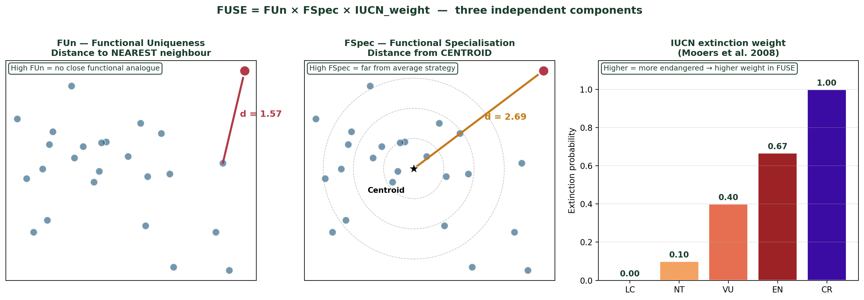
FUn — Functional Uniqueness
THEORY
What FUn measures
Amazon example — Arapaima gigas
Pirarucu has UNIQUE body proportions — no close morphological analogue in the entire Amazonian fish fauna.
Its nearest neighbour (Osteoglossum) sits at d = 1.6 in trait space.
The next closest fish is at d = 0.4 from Osteoglossum — so Arapaima's FUn is 4× higher than the average.
Loss of pirarucu = irreversible loss of the 'giant aerial-breathing predator' role.
FUn = nearest-neighbour distance in trait space.
If the closest other species is FAR, the focal species has no functional analogue.
If the closest is CLOSE, the focal species is functionally redundant.
Trait-Based Ecology — Day 3 · RLQ · Fourth-corner · FUSE · Extinction simulations · Belém, Brazil

Slide 35
FSpec — Functional Specialisation
THEORY
What FSpec measures
Amazon example — Electrophorus electricus
FSpec = distance from the CENTROID of the global trait space.
The centroid is the 'average strategy' of all species pooled.
A species at the centroid = generalist; far from the centroid = specialist.
FUn vs FSpec — what's the difference?
• FUn looks at a SINGLE neighbour. A peripheral species can have low FUn if another peripheral species is close.
• FSpec looks at the GLOBAL average. A peripheral species has high FSpec regardless of its neighbours.
The poraque (electric eel) is the most specialised fish in our Amazonian dataset.
Body shape: extremely elongated (TL/BD > 12) — far from the average Amazonian fish (typical TL/BD ≈ 3).
Eye size: tiny (relies on electroreception, not vision).
Caudal fin: nearly absent — anguilliform locomotion.
→ FSpec is among the highest of any Neotropical fish.
Compare: Astyanax bimaculatus (lambari) sits near the centroid → low FSpec, generalist strategy.
Trait-Based Ecology — Day 3 · RLQ · Fourth-corner · FUSE · Extinction simulations · Belém, Brazil

Slide 36
IUCN extinction weights — Mooers et al. (2008)
THEORY
The Mooers transformation
Should you adapt the weights regionally?
Mooers et al. (2008) propose extinction probabilities derived from demographic models of how IUCN status reflects future risk.
• LC = 0.0 (no extra weight)
• NT = 0.10
• VU = 0.40
• EN = 0.667
• CR = 0.999 (near-certain extinction)
Mooers' weights are GLOBAL averages.
In Amazonia, deforestation pressure means even LC species face non-zero local risk.
Best practice: re-run FUSE with regionally-adjusted weights and compare top-5 lists.
Suggested Amazon rescaling: LC = 0.05, NT = 0.20, VU = 0.50, EN = 0.75, CR = 0.999.
Trait-Based Ecology — Day 3 · RLQ · Fourth-corner · FUSE · Extinction simulations · Belém, Brazil

Slide 37
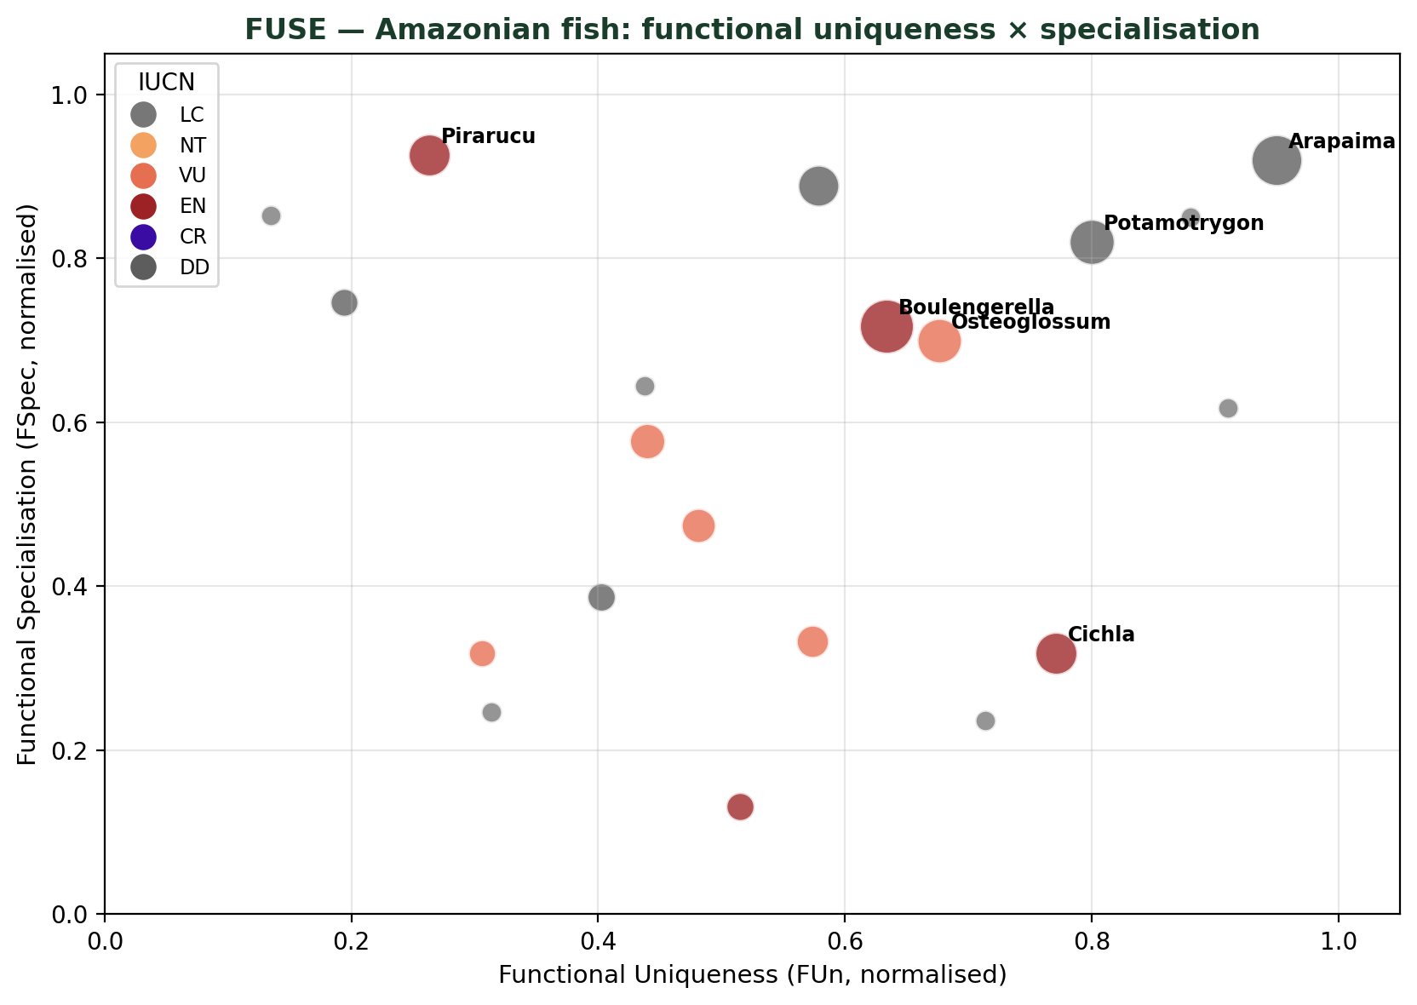
FUSE — Amazonian fish conservation priorities
EXAMPLE
Bubble size = FUSE score · large-bodied threatened species at the upper-right corner

Slide 38
Top-5 FUSE priorities — Amazonian fish
EXAMPLE
1
Arapaima gigas (Pirarucu) [DD]
Largest freshwater fish (3 m). Aerial-breathing. Overfished.
2
Pseudoplatystoma corruscans (Pintado) [VU]
Large migratory catfish. Damming + overfishing.
3
Brachyplatystoma rousseauxii (Dourada) [DD]
Long-distance migrant (6,000 km). Hydroelectric impacts.
4
Potamotrygon motoro (Raia-cururu) [DD]
Freshwater stingray. Unique morphology, aquarium trade.
5
Electrophorus electricus (Poraque) [LC]
Functionally unique despite LC. Habitat loss.
Trait-Based Ecology — Day 3 · RLQ · Fourth-corner · FUSE · Extinction simulations · Belém, Brazil

Slide 39
RLQ biplots + Fourth-corner heatmap
+ Extinction simulations + FUSE scores
1
RLQ biplots
2
Fourth-corner heatmap
rlq_res <- rlq(dudiR,dudiL,dudiQ)
site_sc <- as.data.frame(rlq_res$lR)
sp_sc <- as.data.frame(rlq_res$lQ)
# Biplot: sites + env vectors
# Biplot: species + trait loadings
fc <- fourthcorner2(fc_m2,fc_m4)
# Extract r and p.adj
# Melt to long format
# ggplot heatmap with significance stars
Day 3 · Belém · 30 / 32
3
Extinction simulations
4
FUSE scores
# Baseline FRic and FDis
fd_baseline <- dbFD(trait_mat,comm_mat)
# 3 extinction sequences
# Loop: remove species, recompute FD
# Plot: FD loss curves
# FUn: nearest-neighbour distance
# FSpec: distance to centroid
# IUCN weights
fuse_df <- mutate(sp_meta,
FUSE = FUn_norm*FSpec_norm*IUCN_w)
# Bubble chart: FUn × FSpec

Slide 40
Exercises
EXERCISES
Q1 — RLQ interpretation
Q2 — Fourth-corner critical assessment
a) Re-run the RLQ analysis excluding SeedMass from Q. How does Axis 1 change? Does the main environmental gradient interpretation remain the same?
a) Identify the 3 strongest trait × environment associations from the heatmap. For each, propose a mechanistic biological hypothesis supported by ≥1 published study.
b) Extract the 5 species with highest and lowest scores on RLQ Axis 1. What traits do they share? What environments do they prefer?
b) Re-run the fourth-corner using ONLY model 2 (not the combined max-test). Compare the number of significant associations. Discuss the risk of Type-I error inflation.
c) Compute Moran's I on residuals of CWM(SLA) ~ elevation (use ape::Moran.I). Is there spatial autocorrelation in the trait–environment relationship?
c) The fourth-corner assumes linear relationships. For the strongest association (e.g. elevation × SLA), plot the scatter and fit both a linear and a quadratic model. Is the relationship truly linear?
Q3 — Extinction simulations
Q4 — FUSE in context
a) Add a 4th scenario: 'most common species first' (inverse of B). Compare FRic loss curves of B and D. What does this reveal about functional redundancy of dominant species?
a) Compute FUSE scores for all 30 species. List the top 5 'conservation priorities'. Do they overlap with the species most likely to be lost first in scenario C?
b) Compute the % FRic lost if only CR + EN species are removed. Is this loss greater than expected from random removal of the same number of species? (Test with 999 random permutations.)
b) The IUCN weights used in FUSE are global. Propose how you would adapt these weights for a regional Amazonian context where deforestation pressure creates different extinction probabilities.
c) Identify the species with the highest FUn. To which functional group does it belong? Visualise its position in PCoA space relative to all others and explain what makes it unique.
c) Discussion (≥150 words): why might functionally unique species be more vulnerable to extinction than functionally redundant ones? What ecological mechanisms could explain this pattern?
Day 3 · Belém · 31 / 32
Trait-Based Ecology — Day 3 · Belém, Brazil

Slide 41
Take-Home Messages — Day 3
1
RLQ finds the combination of environmental variables and functional traits that maximises covariance, weighted by species abundances — providing a multivariate test of the response–effect framework.
2
Fourth-corner tests each trait × environment pair with a permutation approach (model 2 + model 4 max-test). Always apply FDR correction across the full matrix of associations.
3
Extinction order matters: threat-sorted extinction causes faster functional diversity loss than random extinction, because threatened species tend to be functionally unique (Mouillot et al. 2013).
4
FUSE combines functional uniqueness (FUn), specialisation (FSpec) and IUCN extinction probability. High FUSE species represent irreplaceable functional roles facing imminent loss.
5
In Amazonia, large-bodied fish (arapaima, giant catfish, stingrays) score highest on FUSE — they are morphologically unique, ecologically specialised, and among the most threatened by overfishing and habitat loss.
Day 4 → Introduction to fish morphological traits & landmark measurements (freshwater fish of the Amazon)
Day 3 · Belém · 32 / 32

